Slide 1



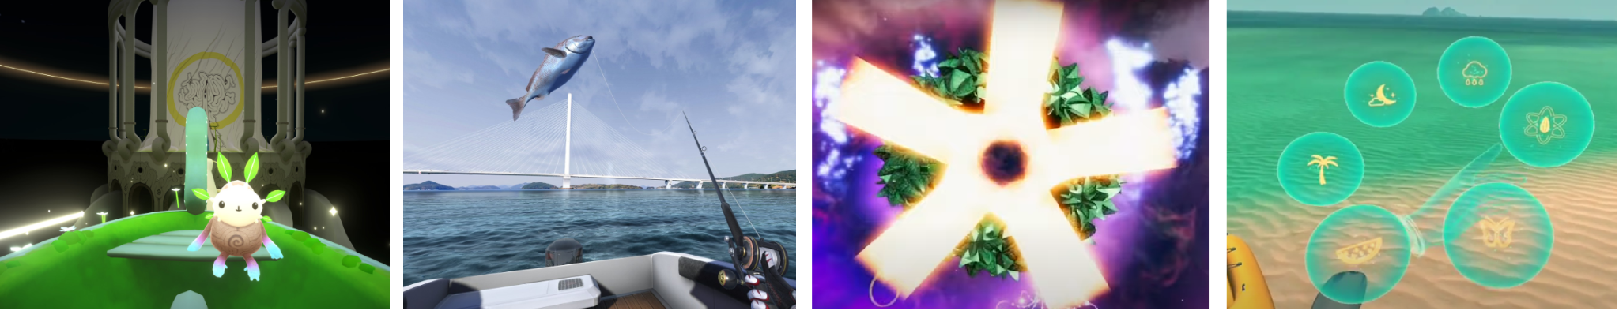
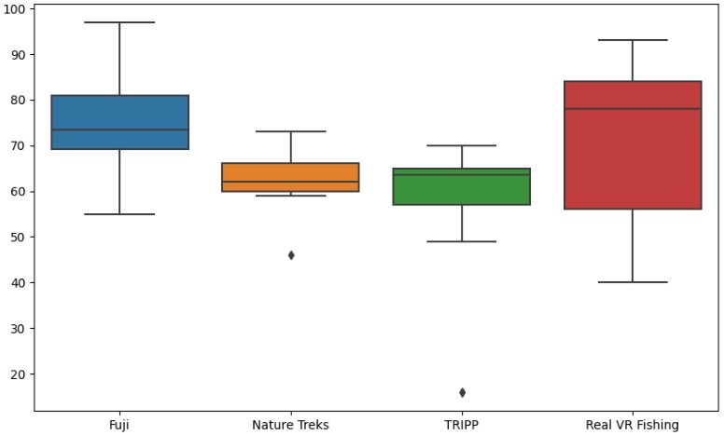
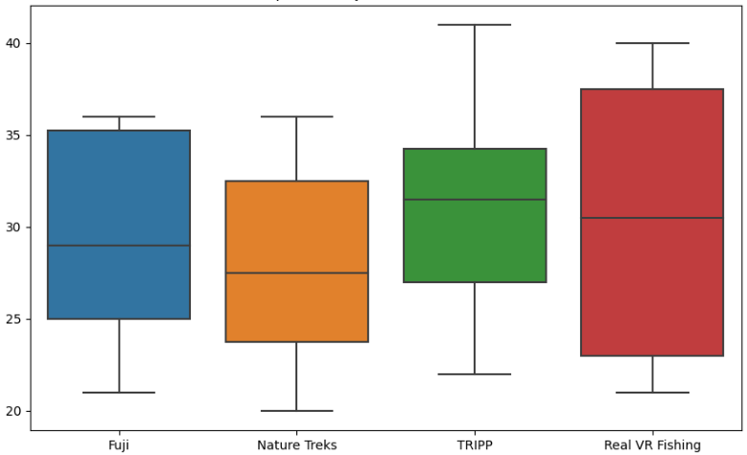
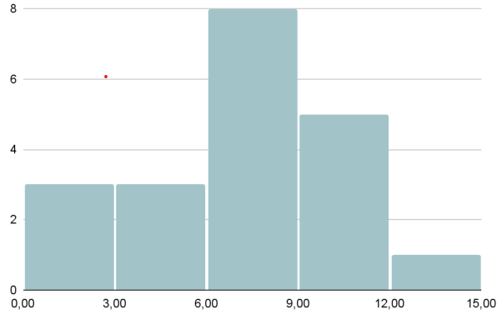
Exploring User Preferences in VR Relaxation Experiences:
A Mixed-Methods Study
JAGIELLONIAN
UNIVERSITY
IN KRAKÓW
This comparative study presents the results of a user experience investigation conducted during the use of relaxing VR applications. Four different experiences, distinguished by style and interactivity (Fujii, Real VR Fishing, TRIPP, Nature Treks VR), were tested by 12 participants in a balanced order, within a within-subjects scenario. Both immersion and anxiety were measured. Semi-structured individual interviews were conducted to understand user preferences. Among the most frequently suggested features, personalization and voluntary microinteractions appeared to be the most preferred.
the experience combines elements of outdoor adventure with creative gardening
very realistic VR fishing experience, which allows the player visit various places and fish there
meditative experience that allows one to focus and calm down through meditations, simple games, and full-color or fractal visualizations
the player wanders through nature scenes such as, a forest, beach, meadow or space and has the ability to edit the place by, for example, planting trees or flowers.
Fujii
Real VR Fishing
TRIPP VR
Nature Treks VR
randomization with balanced square matrix
12 participants
(8F, 4M)
half of them without previous VR experience
measuring initial anxiety level
(STAI-I)
4x
UX & usability test
4x
+ immersion questionnaire + anxiety questionnaire (STAI -I)
semi-structured interview : the justification of the most and least preferred experience, an experience to choose one day / one hour before a stressful event to relax; elements that were most important in the context of relaxation, the biggest distractions that prevented from relaxing, how the best / worst relaxing experience should be like, preferred graphics style.
with different Personal Report of Confidence as a Speaker
A
B
Immersion levels (A) and anxiety levels (B) measured for the investigated VR experiences.
Fujii was often chosen as a favorite for its pleasant music, ambient sounds, environment interactions, and light tasks that didn't penalize mistakes. Fujii was often chosen as the game to use the day before a stressful event,
Opinions on Real VR Fishing varied greatly, with some respondents praising its movement requirements, clear objectives, and graphics, while others found the competitive element stressful.
TRIPP was frequently criticized for its limited interaction, monotonous tasks, intense music, and lack of customization.
Nature Treks, despite not being the most immersive (third in the ranking), can induced the lowest anxiety levels. Most frequently chosen as a game to use an hour prior a stressful event. Notably, Nature Treks was chosen for its ability to provide a short and undemanding disconnection from reality without becoming overly engaging.
General recommendations for a relaxing VR experience: Style: Some respondents favour realistic graphics, while others prefer unrealistic ones. As suggested by several respondents, it might be optimal to amalgamate both conventions. Music: It's essential for players to be able to select their own type of music, as each individual may find different music types relaxing. There should also be an option to turn off the music. Gamification: Tasks, mini-games, or quests in a relaxing game should be voluntary, not imposed by the gameplay. Players may choose to participate in them, but they shall not obligated to do so. Simple interactions with the environment: The ability to immerse oneself in the virtual world and interact with it was crucial for relaxation. A relaxing game should allow for many minor interactions, such as petting animals or grabbing objects.
Gabriela Wrońska, Radosław Sterna, Grzegorz Łukawski, Magdalena Igras-Cybulska
ID: 1204

